Slide 1
A Comprehensive Analysis of Covid-19 Data
Insights Derived Using Tableau Dashboards
Presented by:-
TARANG VERMA (2201331520194)
VISHAL VERMA (2201331520211)

Slide 2
Index
Dashboard Overview
Data Set Import and Preparation
Age Group Details
Covid Cases by States
Doses Administered by Vaccine
First vs Second Dose Administered
Gender Without Missing Values
ICMR Testing Labs in Each State
Map Total Deaths by State
State-Wise Testing Details
Conclusion

Slide 3
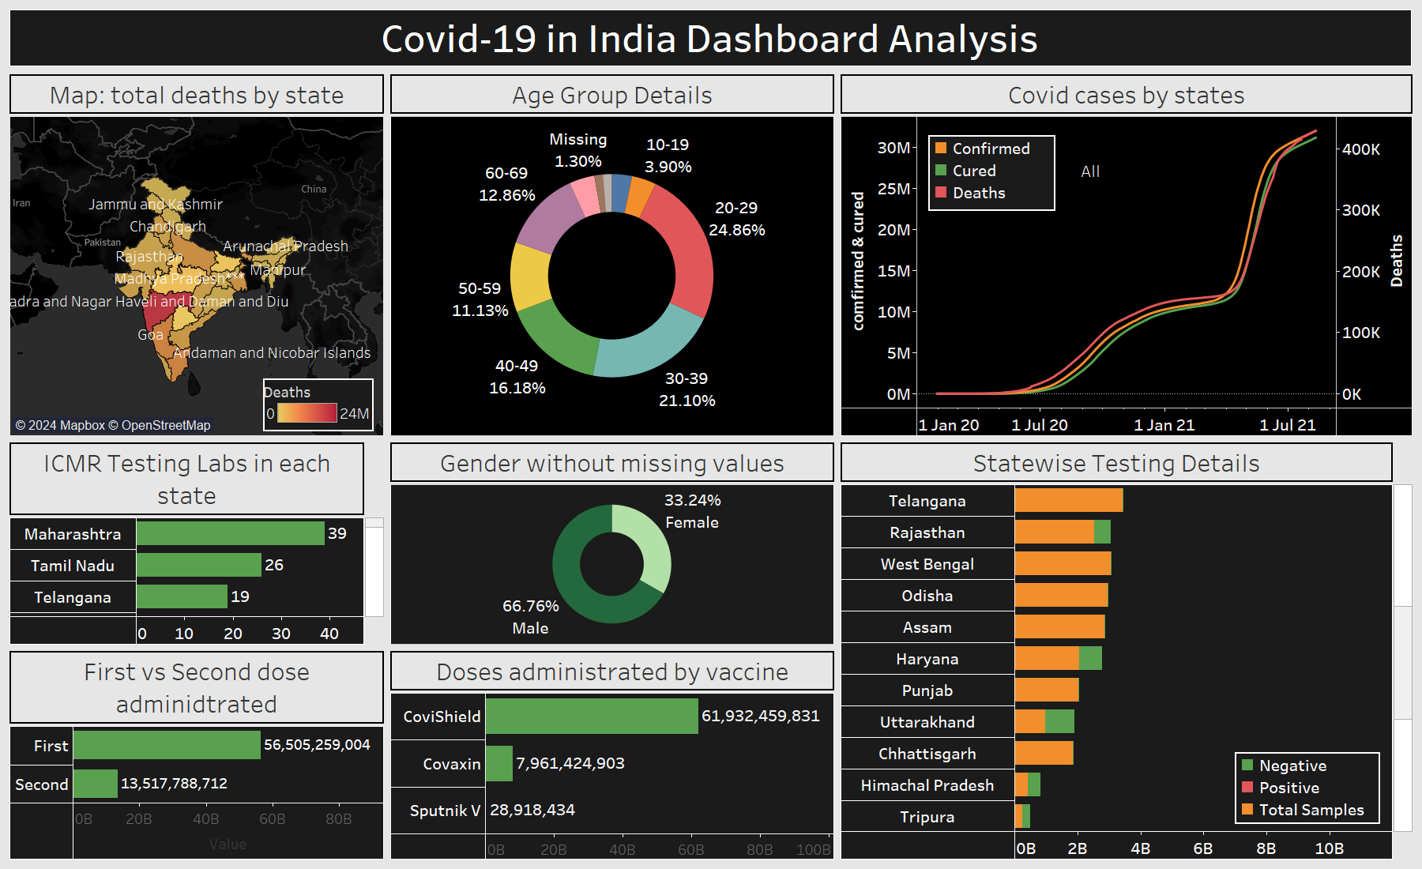
Dashboard Overview
The interactive Tableau dashboard aggregates key Covid-19 trends, including age demographics, vaccination details, gender distribution, testing data, and geographical patterns. It provides an intuitive and comprehensive view of the data, aiding in informed decision-making for healthcare and policy stakeholders.

Slide 4
Data Set Import and Preparation
This dataset uses six key CSV files sourced from Kaggle, providing essential COVID-19 data.
The dataset includes information on Covid-19 cases, vaccination distribution, gender demographics, testing details, and state-wise trends.
Files include ‘covid-19_india.csv’, ‘statewise_testing_details.csv’, ‘covid_vaccine_statewide.csv’, ‘age_group_detail.csv’, ‘icmr_testing_labs.csv’, and ‘individual_details.csv’.
Preprocessing steps included cleaning missing values, standardizing formats, and aggregating data for reliable and accurate Tableau visualizations, and insightful analysis of the pandemic.

Slide 5
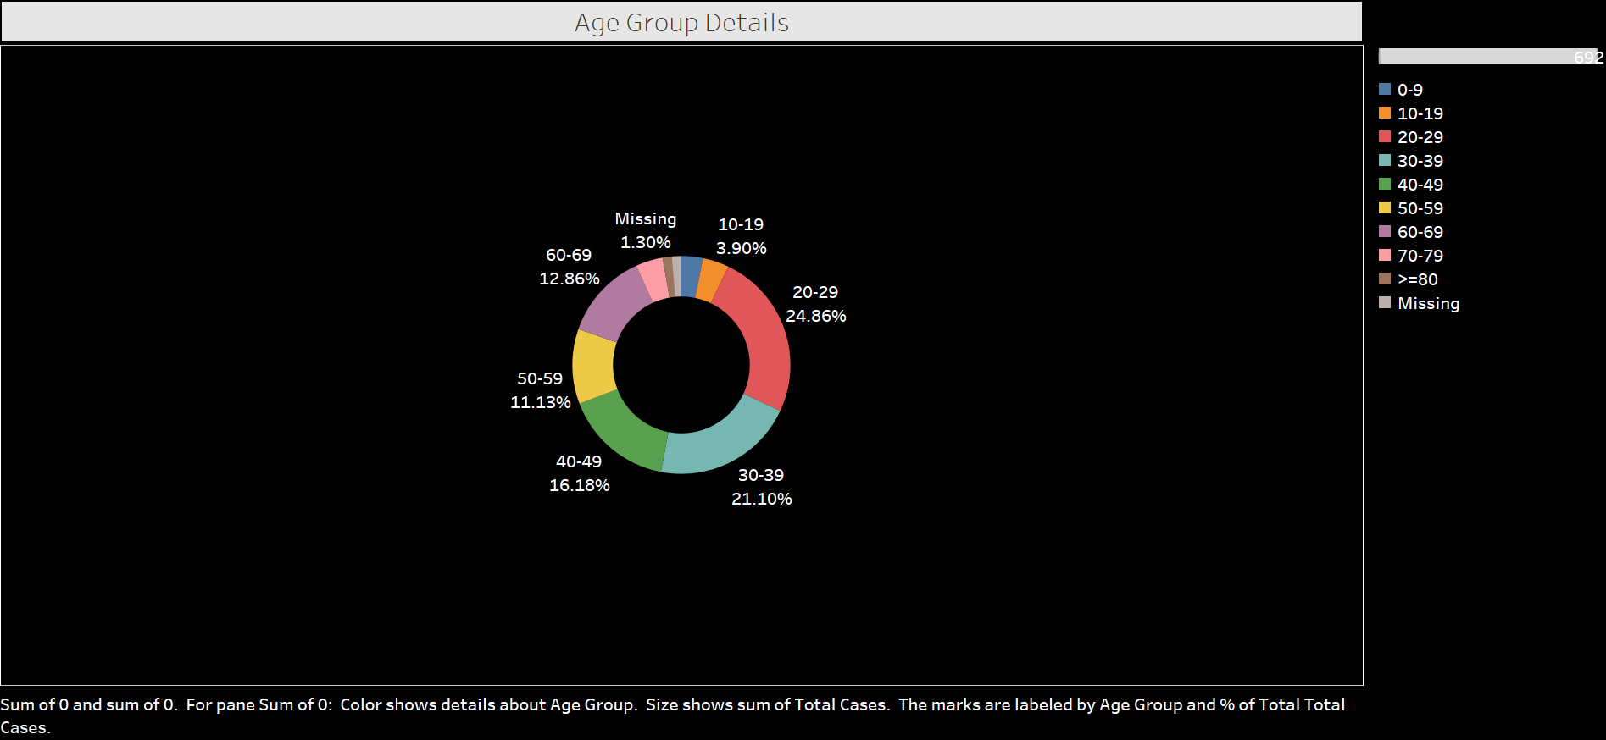
Age Group Details
This visualization categorizes individuals into age groups, showing the most and least impacted demographics. It highlights trends in Covid-19 cases and vaccination efforts, offering actionable insights for targeting specific age groups in public health initiatives.

Slide 6
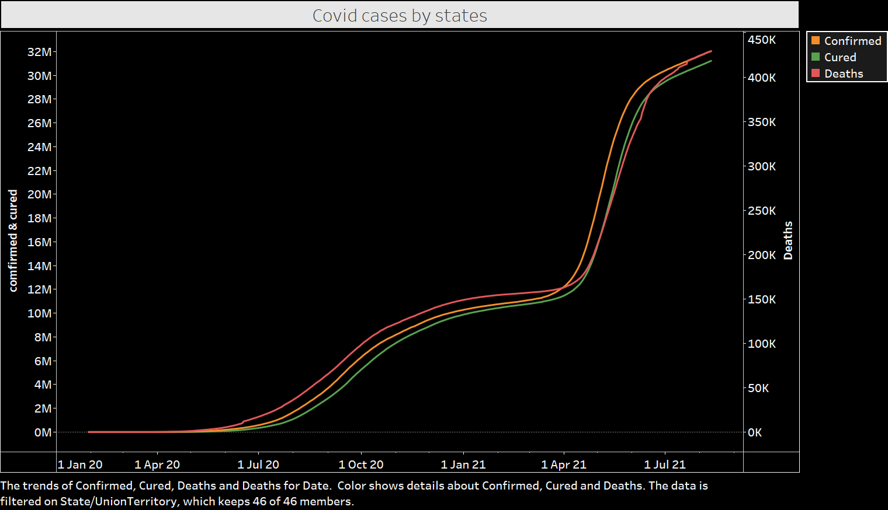
Covid Cases by States
This slide presents state-wise Covid-19 case data, showcasing regions with high and low case counts. It explores factors like population density and healthcare resources, providing insights into how states managed the pandemic and what measures worked effectively.

Slide 7
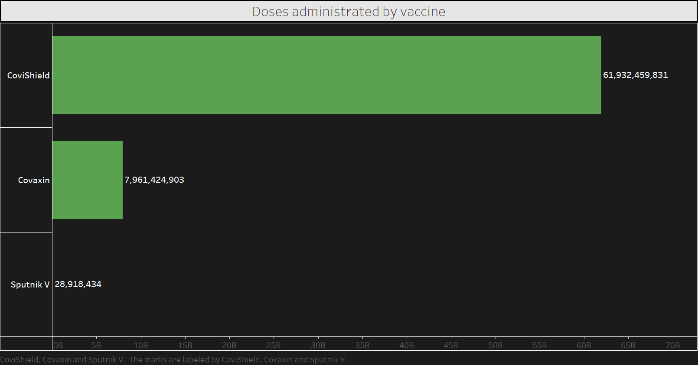
Doses Administered by Vaccine
A comparative analysis of vaccine types highlights distribution trends, showing which vaccines were most and least utilized. The data reveals public preferences, supply dynamics, and their impact on vaccination progress.

Slide 8
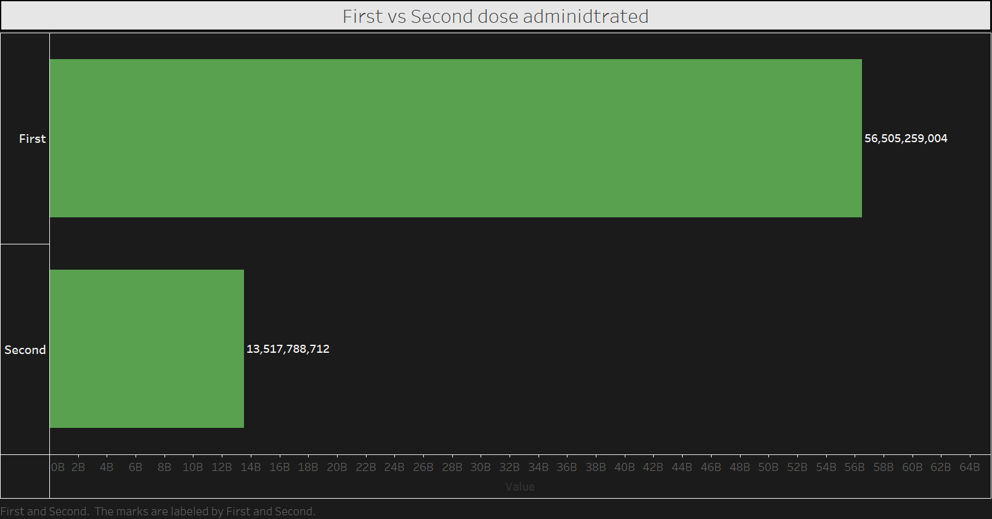
First vs Second Dose Administered
This slide compares the first and second doses administered, revealing gaps and trends in completing immunization cycles. It examines factors like vaccine availability, public willingness, and policy interventions influencing the outcomes.

Slide 9
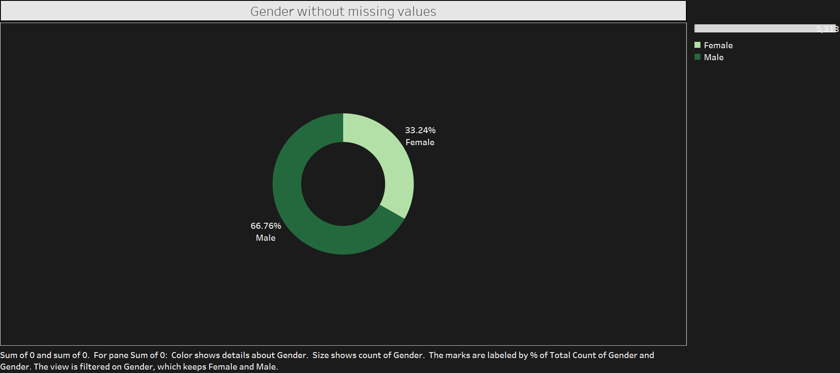
Gender Without Missing Values
The gender distribution data, cleaned of missing values, highlights representation in Covid-19 cases and vaccinations. It offers insights into gender-specific trends, ensuring equity in healthcare interventions and public health measures.

Slide 10
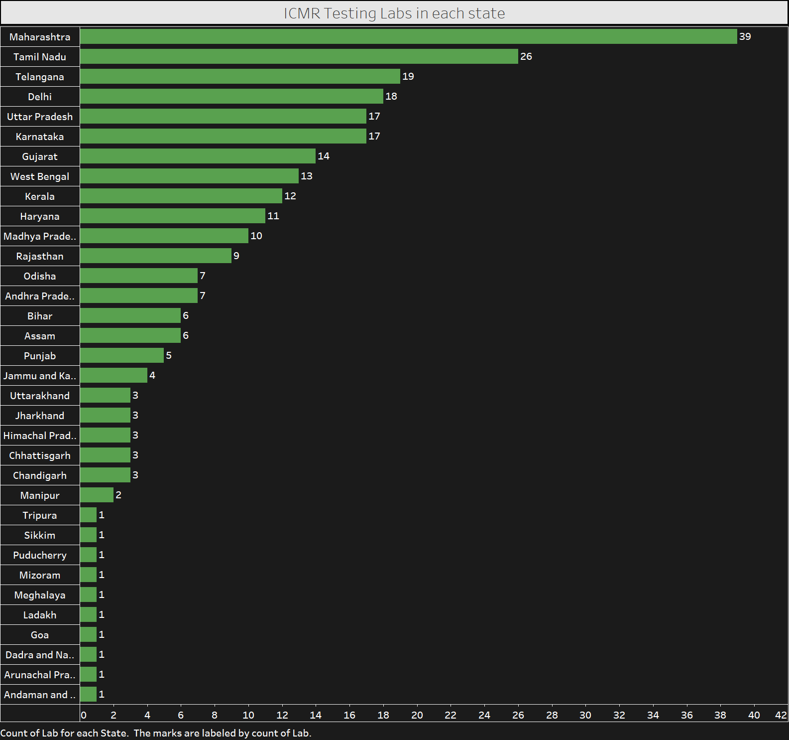
ICMR Testing Labs in Each State
This slide maps the distribution of ICMR testing labs across states, highlighting areas with robust testing infrastructure and those needing improvements. Testing lab density directly correlates with efficient Covid-19 containment efforts.

Slide 11
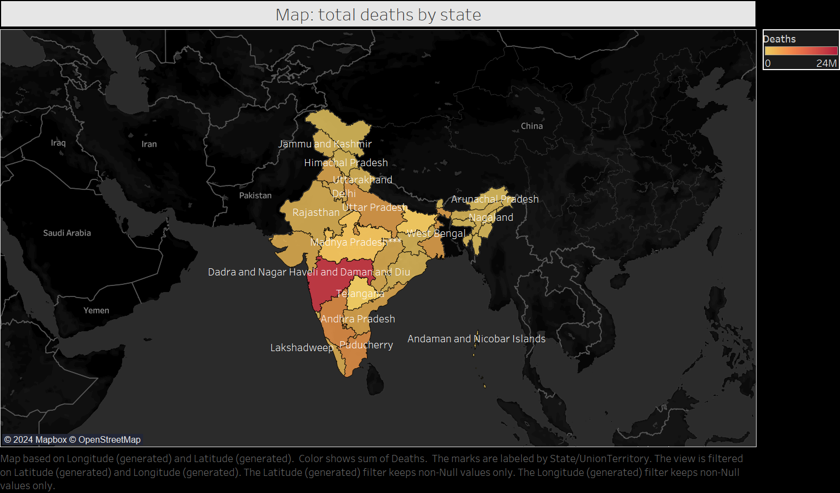
Map Total Deaths by State
A heatmap visualizes the geographical disparities in Covid-19 mortality rates. Factors such as healthcare access, demographics, and pandemic response strategies are explored to understand variations across states.

Slide 12
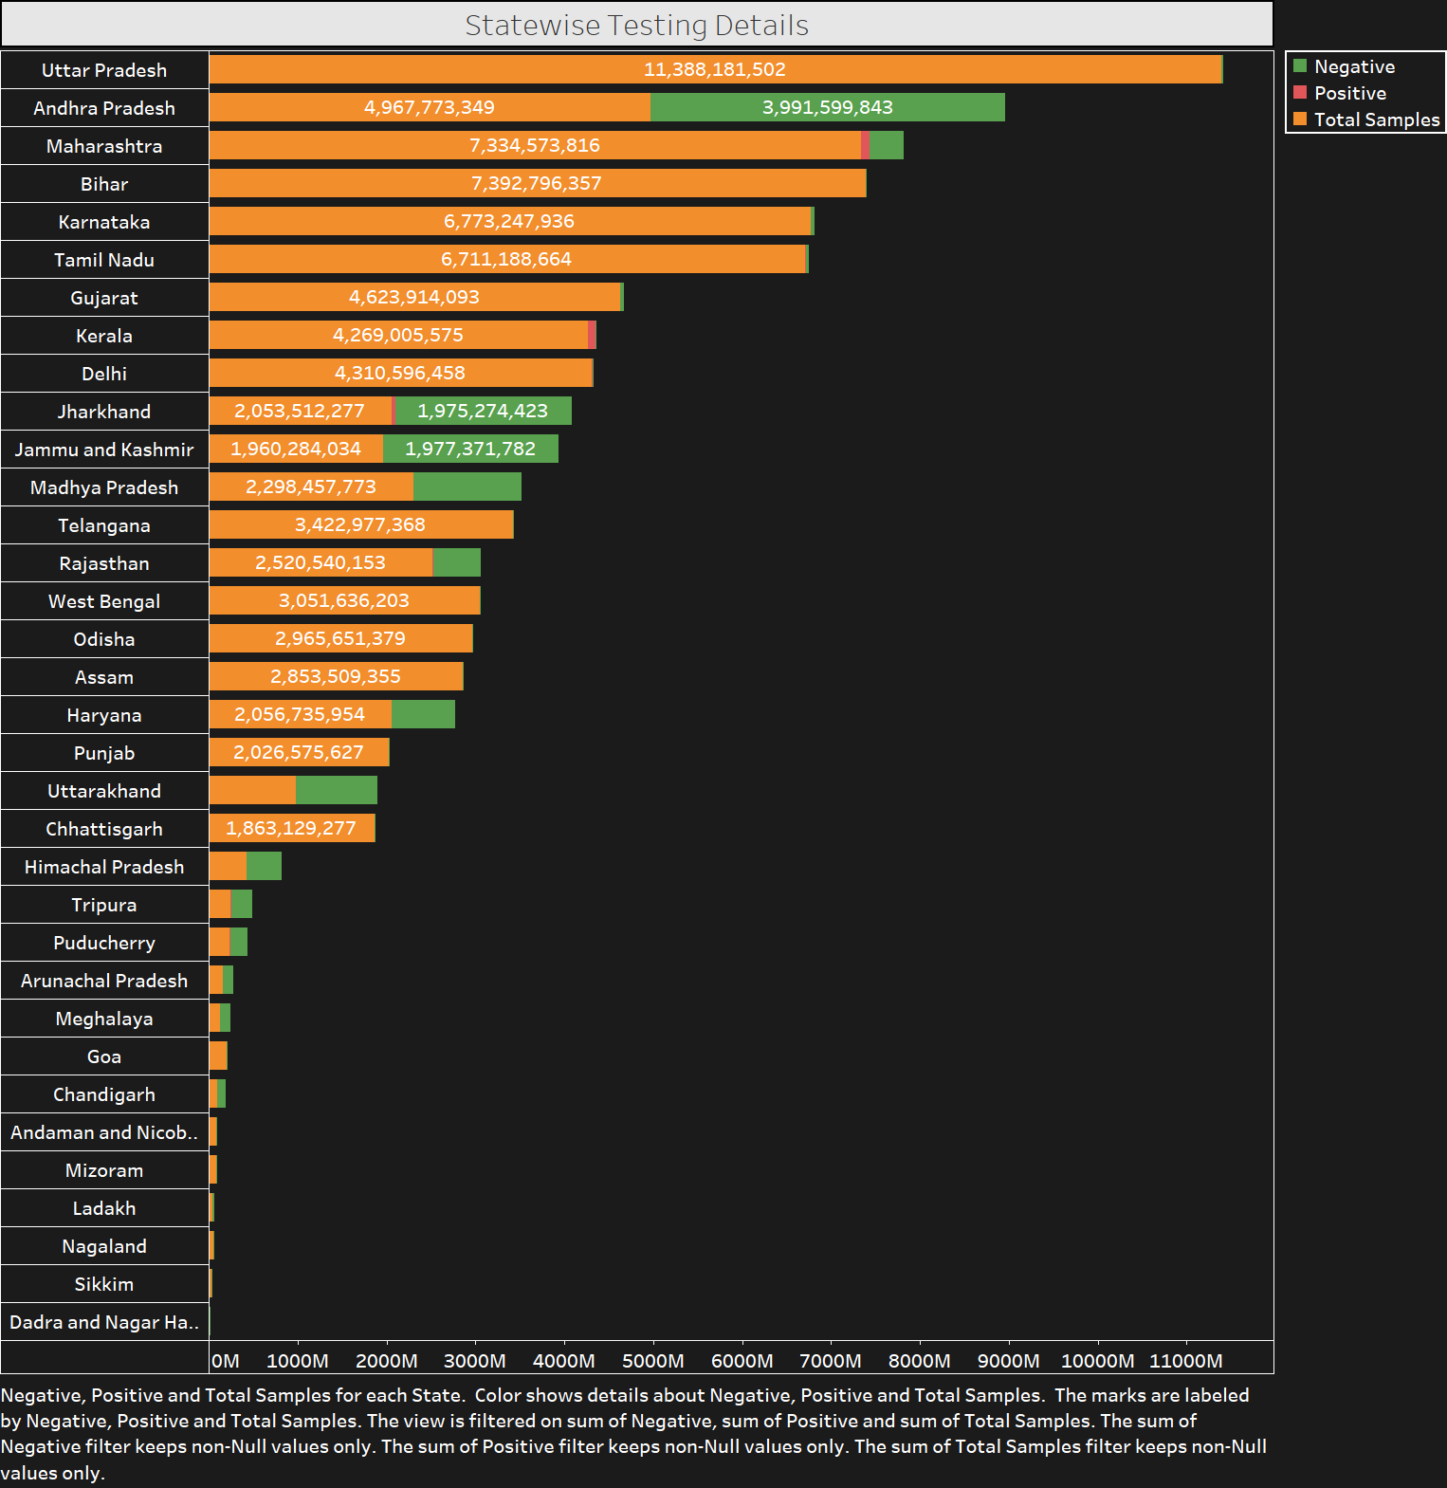
State-Wise Testing Details
This slide details state-wise testing statistics, including total tests conducted and positivity rates. It highlights states with exemplary testing efforts and those requiring improvement, emphasizing the role of widespread testing in controlling the pandemic.

Slide 13
Conclusion
Key takeaways include trends in age and gender demographics, vaccination progress, testing infrastructure, and geographical mortality disparities. These findings guide policymakers in resource allocation, improving vaccination coverage, and strengthening healthcare systems for future preparedness.

Slide 14
Thank You
Thank you for your attention to this Covid-19 data analysis presentation. Feel free to reach out for your feedback.

